Slide 1
Robust Reference Frame Extraction from Unsteady 2D Vector Fields with Convolutional Neural Networks
Byungsoo Kim and Tobias Günther
Department of Computer Science, ETH Zurich

Slide 2
Background
robust extraction of vortices for unsteady vector field is needed
insensitive to noise and other distortion artifacts
Vortices are studied in applications such as: engine design, blood flow analysis, atmosphere of other planets
Vortex: a set of particles rotating around a common point or axis, if the flow is viewed in the correct reference frame
This makes vortex extraction in unsteady flows difficult
Notes:
Intro:
existing methods concentrated on vortex characterizations that give the same result for many different reference frames or from a smooth rotation and translation of the reference frame
local search for the steady reference frame: (an optimization problem)
But robustness to noise and resampling artifacts is a major concern when it comes to the local vortex extraction

Slide 3
Contribution
Utilize CNN to extract a steady reference frame for a given unsteady 2D vector field
Conditioning the NN to noisy inputs and resampling artifacts
Achieved numerically stabler results than existing optimization-based approaches
Creation of a vector field benchmark data set for local deep learning-based feature extraction
Formulate a parametric vector field mixture model
Can efficiently synthesize thousands of vector fields
Model is slightly slower than a linear optimization but more robust on real-world data
Notes:
Vatistas velocity profile

Slide 4
Related work
Deep learning for VIS
CNN for Vortex Extraction

Slide 5

Related work
Objective Vortex Extraction
Objective: a measure remains invariant under a smooth rotation and/or smooth translation of the reference frame
a measure looks the same for different rotations / translations of the observer
Transform a point (x, t) to location (x*, t*),
a constant time shift
a time-dependent translation vector
a time-dependent rotation matrix

Slide 6




Related work
evaluation of Eq (2) requires to transform (x*, t*) into old frame (x, t) in order to sample the given vector field v(x, t) at correct location
Reference Frame Transformation of a Vector Field
NN needs to recover a reference frame transformation Q(t), c(t)
A large # of unsteady VFs with a known GT transformation is required
a vector field v(x,t) transformed into a new frame via:
rearrange into:
Insert (3) into (2), we can uniformly sample the space domain (x*, t*) onto a regular grid; (which is later fed with the corresponding transformation Q(t) and c(t) to the NN during training)
Notes:
GT: ground truth
In order to train a network that recovers a reference frame transformation Q(t), c(t) in which a vector field appears steady, need to generate a large number of unsteady vector fields with a known ground truth transformation.
Start from a steady vector field and transform It with many random reference frame transformations, which makes each resulting flow unsteady.

Slide 7


Related work
Reference Frame Optimization
not a single reference frame exists in which all vortices become steady
the frame needs to be searched locally (an optimization problem)
Method: minimize the time partial of the transformed field v∗ (Eq 2) in a local neighborhood U
unknowns are the 1st and 2nd derivatives of the rotation and translation, evaluated at time t :
Notes:
GT: ground truth

Slide 8
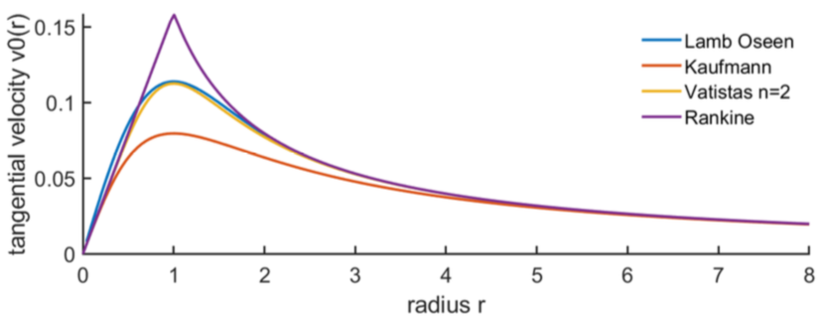
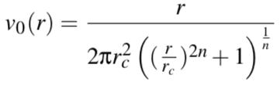
Synthetic Generation of Vector Fields
Vatistas Vortex Velocity Profile
tangential flow velocity v₀(r) of a rotationally-symmetric unit vortex
r_{c}: the radius with maximal velocity
Vatistas’ vortex model contains other well-known vortex models
For n=1: Kaufmann vortex
For n→∞: Rankine vortex
For n=2: similar to the Lamb-Oseen vortex model
the core radius r_{c} and the shape exponent n as degrees of freedom in the parametric model
Fig 1.
Notes:
incorporate experimental observations to formulate an explicit parametric vector field mixture model
increasing n, the behavior near the critical point becomes linear
figure 1 is a plot of common vortex velocity profiles. Starting from the center, the tangential velocity increases up until a certain maximum. Afterwards, it decays with increasing distance.

Slide 9
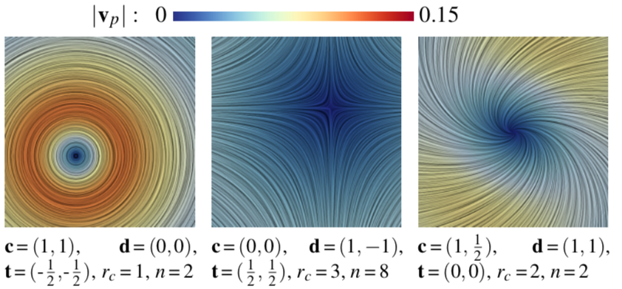



Synthetic Generation of Vector Fields
Parametric Mixture Model
Define a steady flow primitive v_{p} with a critical point at t = (t_{x},t_{y}) as:
c = (c_{x} , c_{y} ) describes the vortical motion
d = (d_{x} , d_{y} ) denotes the in-flow and out-flow
Each primitive has eight degrees of freedom: c_{x} , c_{y} , d_{x} , d_{y} , t_{x} , t_{y} , r_{c}, and n
Different flow structures appear: vortices, sinks, sources and saddles
Use a mixture model of m flow primitives:
results in 8 m parameters
Fig 2.
Notes:
Figure 2 is a plot of examples of steady 2D flows, generated by model in Eq(6), shown for the spatial domain D = [−2, 2]²
To find physically plausible parameter configurations, we fit the mixture model to patches of a numerical data set

Slide 10

Synthetic Generation of Vector Fields
Parameter Space Fitting
fit the above model to numerically simulated vector fields
restrict the parameter space to physically-plausible flows
Distance metric for fitting the VFs: L1 distance with gradients:
Goal: (training data) generate a vector field collection that represents flows in optimal near-steady reference frames, using Eq(7)
1st: extract the optimal reference frame
2nd: use 200 iterations of simulated annealing + further 200 iterations of gradient descent to settle into local minimum
distance metric for compressible flows
Notes:
Compressible flow is the area of fluid mechanics that deals with fluids in which the fluid density varies significantly in response to a change in pressure.
L1: vˆ and v are the vector fields to compare, λ is a weight for the gradient difference
λ = 1
parameters in Eq(7) are not linear, first use 200 iterations of simulated annealing followed by further 200 iterations of gradient descent to settle into the local minimum

Slide 11
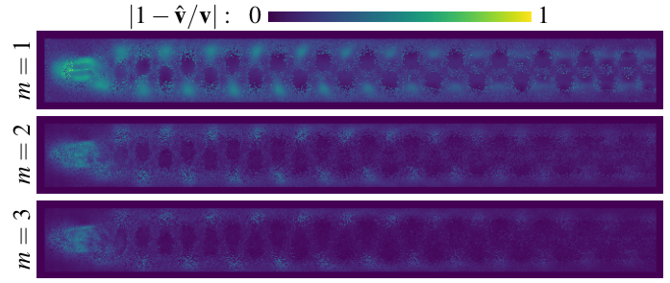
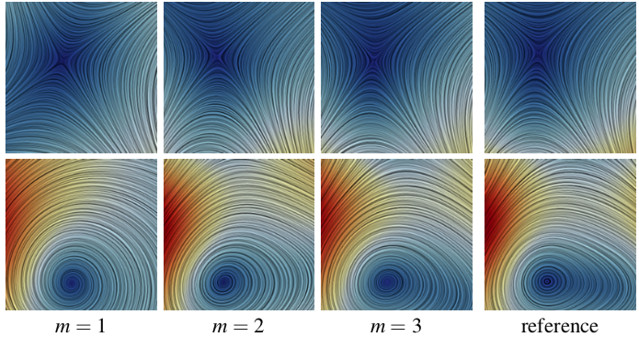
Synthetic Generation of Vector Fields
Parameter Space Fitting
Fig 3: Heatmaps of the fitting residual for varying number of mixture model components m
Fig 4: Fitting results for selected vector field patches. The fitting improves with more degrees of freedom, i.e., for a higher number of models m.
Notes:
Fig 3 shows a heat map in the CYLINDER flow, displaying for each voxel in the domain, how closely we could fit the numerical data with our parameteric mixture model.
Fig 4: displays how closely the mixture model matches the numerical data for the varying numbers of model components m
use m = 3 models later during the vector field synthesis

Slide 12
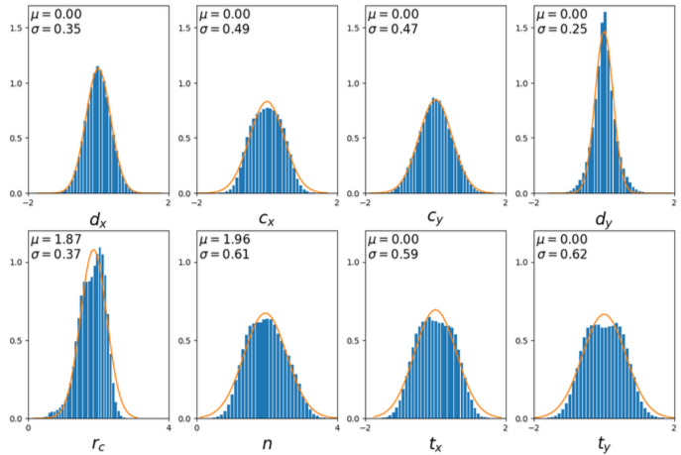
Synthetic Generation of Vector Fields
Sampling of the Parameter Space
Individually approximate distribution of each parameter (c_{x}, c_{y}, d_{x}, d_{y}, t_{x}, t_{y}, r_{c}, and n) by a separate Gaussian distribution N
Neglect the correlations and sample each variable independently (to span a wider range of VFs)
Insert the resulting parameters into the parametric model in Eq. (7), resulting a new analytic vector field
Fig 5: Histograms of the individual model parameters, showing the near- Gaussian distribution of the individual parameter values.
Notes:
Fig 5 shows histograms of the individual parameters. The histograms are used later to sample further vector fields
The histograms characterize the distribution of model parameters needed in order to generate further vector field patches of similar type.

Slide 13
Deep Learning of Reference Frame Extraction
Use a CNN model that spans two stages of visualization pipeline: the filtering and the feature extraction
Reference frame extractor can be conditioned to handle noisy inputs and data with resampling artifacts
supervised learning:
Training data: pairs of unsteady vector fields (v∗ ∈ R^{T×H×W×2}) and their corresponding optimal reference frame transformation
Notes:
training examples are generated by transforming a steady vector field into an unsteady reference frame
By distorting the input data, the network learns to undo artifacts, which greatly improves robust- ness and helps in subsequent feature extraction tasks, such as the detection of vortex centers

Slide 14
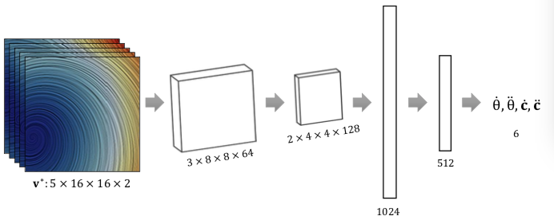
Deep Learning of Reference Frame Extraction
Architecture
infer the first and second-order derivatives of the reference frame transformation Q ̇ ,Q ̈ ,c ̇,c ̈ in 2D
Output:
optimal reference frame transformation
Input:
vector fields (v∗ ∈ R^{T×H×W×2})
Fig 5.
Notes:
Training data: pairs of unsteady vector fields (v∗ ∈ R^{T×H×W×2}) and their corresponding optimal reference frame transformation
In fig 5, numbers below represent the dimension of feature maps.
Output are the 1st and 2nd derivatives of the rotation (Q) and translation (c), evaluated at time t

Slide 15
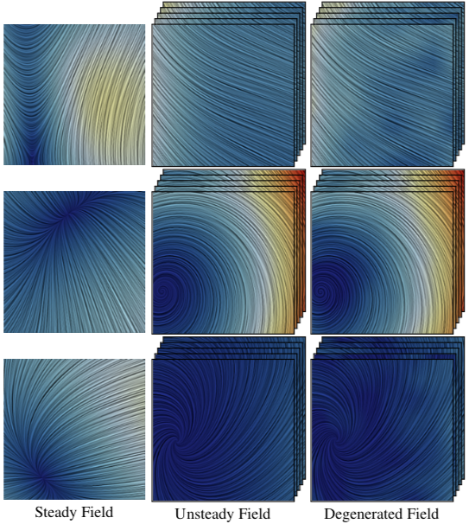
Deep Learning of Reference Frame Extraction
Data Sets
Synthesized, based on Vatistas velocity profile
Steady field is generated by a super-position of three models with sampled parameters
Unsteady vector fields is generated by:
Apply a reference frame transformation
parameters for the rotation and translation [θ ̇ , θ ̈, x ̇, y ̇, x ̈, y ̈] are uniformly sampled
Degrade it by varying degrees of additive uniform noise (i.e., white noise) and down-up resampling
#samples: 30, 000
training and testing is split into the ratio of 9:1
Fig 6
Notes:
chose white noise during training, but also test the network on a data set that was corrupted with Gaussian noise

Slide 16

Deep Learning of Reference Frame Extraction
Data Sets
Patch Normalization
Training data is defined in:
Given velocity patch slices v_{p}: with domain
compute v ̄_{p} in the unit domain via:
Then, globally normalize magnitude of the training data to [−1, 1]
Implementation
Keras, 300 epochs, lr = 0.001, loss: MSE, batch Size: 256

Slide 17
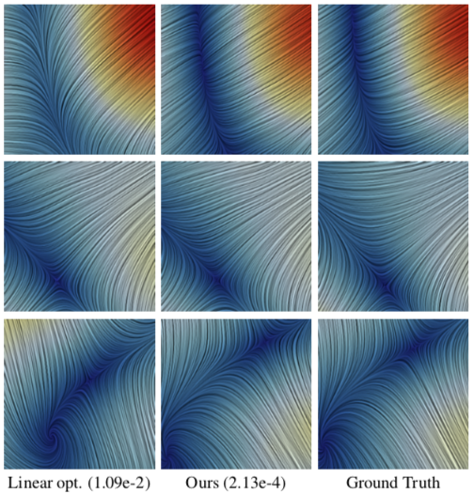
Result
Synthetic data
baseline: linear reference frame optimization
outperform the baseline
Fig 7: Results of vortex extraction
The numbers in parenthesis are MSE
Notes:
Their method robustly handles degenerated flows where linear optimization method fails.

Slide 18
Result
Numerical Data
Robustness
introduce varying degrees of noise and resampling artifacts into the unseen validation data
baseline: linear reference frame optimization
Error Metric
Use the reference frame transformation obtained by the network or by linear optimization
Calculate time partial derivative:
If |vt | = 0: NN successfully found reference frame transformation, despite presence of noise.
Transform unsteady vector field vt* back into steady frame vt
Notes:
CNN has enough information to learn proper smoothing and filtering kernels, such that noise and resampling artifacts can be compensated

Slide 19
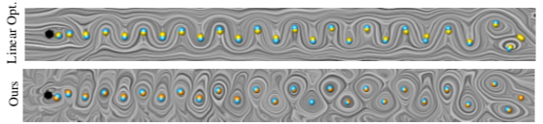
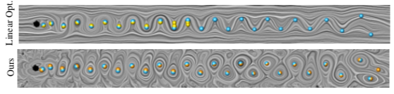
Result
Numerical Data
Robustness
Quantitative Experiment: use CYLINDER flow as benchmark:
Swirling strength of the vortices in this VF reduces over time => vortices become weaker => influence of the artificially added noise becomes stronger
Cause errors in the linear optimization
CNN robustly recover reference frame (even for different levels of degeneration)
Fig 8: Results of the reference frame optimization on the resampled CYLINDER data set with the factor of 5
Fig 9: Results of the reference frame optimization on noise-added CYLINDER data set. The ratio of noise to the maximum magnitude of flow is 0.01 (1%)
Notes:
Our method shows robust performances for various degradations. In this experiment, the network was trained for 1% noise and with resampling artifacts.

Slide 20
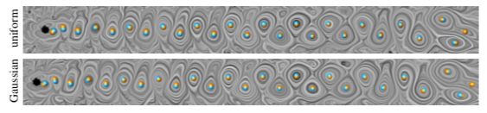
Result
Numerical Data
Robustness
Noise Type Experiment
Apply their network (trained on 1% uniform noise and with resampling artifacts) to a dataset with 1% of Gaussian noise
Network can handle this type of noise as well (For higher noise magnitudes, better to train a network with Gaussian noise)
Fig 10: Results of CNN-based reference frame optimization on two different types of noise in the CYLINDER flow. During training only uniform noise was seen by the network (1% magnitude)
Notes:
CNN has enough information to learn proper smoothing and filtering kernels, such that noise and resampling artifacts can be compensated

Slide 21
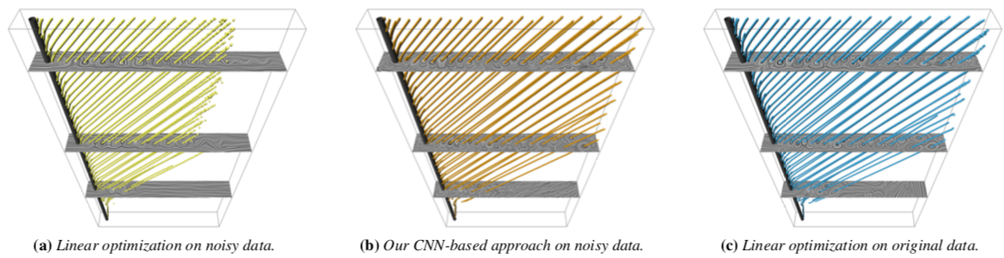
Result
Numerical Data
Robustness
Temporal Coherence
Vortex corelines resulting from the linear optimization are disconnected and partially missing on noisy data
CNN-based method finely extracts the corelines
Fig 11: Comparison of vortex corelines in space-time in the CYLINDER flow
Notes:
Despite the noise and resampling artifacts, CNN-based method recovers the reference frame well, so that vortex corelines can be extracted as cleanly as with the linear optimization on the original data

Slide 22
Performance
Generating the 30,000 training patches took in total about 37 seconds
compute unsteady flow patches (24s) + compute steady ground truth(13s)
Training time: 10 minutes
Model size: 20.9MB in HDF5 format
22ns on average for a feed-forward evaluation of a single patch
Notes:
Despite the noise and resampling artifacts, CNN-based method recovers the reference frame well, so that vortex corelines can be extracted as cleanly as with the linear optimization on the original data

Slide 23
Discussion
Limitations
Generalization capacity is limited to the training data
Our network has not seen obstacles or boundary data
Our parametric mixture model is not yet expressive enough to approximate turbulent and small-scale structures accurately
Currently concentrated on 2D time-dependent data, next step is to 3D
Choice of Basis
Other options to form the parametric vector field model
such as monomial, Chebyshev and Fourier basis functions
Radial basis functions have been used to combine primitives
more intuitive results than adding up
Noise in Linear Method
Noise can have a significant impact on the linear method
Second-order accurate finite differences are prone to noise
CNN-based approach removes the noise implicitly
Notes:
our primitives have a strong prior, since they are derived from models that were fit to experimental data
Adding noise of only 1% to v in the CYLINDER flow already increased the noise level in the time partial vt by 14%.

Slide 24
Conclusion
Developed a CNN that extracts the reference frame
a given unsteady 2D vector field becomes steady
Trained the network on distorted inputs
increase the robustness to noise and resampling artifacts
Generated the required training dataset
Developed a parametric vector field mixture model that is based on Vatistas’ experimentally obtained vortex velocity profile
Parameterize the parametric vector field mixture model
Fitted the model to numerical data
Then, sampled thousands of training data sets.
Notes:
Potential of deep learning for end-to-end combinations of preprocessing and feature extraction

